Slide 1
Your Students, Your Post-School Outcomes: Accessing Your New PSO Reports
OAVSNP 2014
Charlotte Alverson, NPSO
Pattie Johnson, TRI
Sally Simich, ODE
Notes:
knowledge, strategies, and use of PSO data at different conferences

Slide 2
Q and A about PSO
How many of you called students in the past for PSO data collection?
How many of you will call students this spring/summer for PSO data collection?
Share positive strategies for those who may be new to the process
Tell us about any trouble or concerns you’ve encountered
How many of you have seen your district data after they were collected?

Slide 3
PSO Data Collection
PSO data are collected on youth who the districts report left school the previous year, including graduates, age-outs, dropouts, and excludes youth who were not expected to return, but did.
All districts are required to participate each year. Student selection is based on a stratified sample designed to generate a representative sample of leavers to ensure generalizable information.
Districts select who will conduct the interviews, and data entry is open from June through September. Interviews can be completed with young adult or their family members.

Slide 4
Response Rate & Representativeness
Response rate – one measure of the quality of interview data
Defined as the number of completed interviews divided by the number of youth eligible to take the survey
Representativeness – measure of how similar those who respond to the interview are to the target population
Parameter guidelines set by NPSO, and approved by OSEP, as +/-3%

Slide 5
Have we interviewed the right students?
Completing Interviews with a representative sample of the students who left school the previous year allows Oregon to make statements about all students by disability, gender, race/ ethnicity and dropout.
Year | LD | ED | ID | All Others | Female | Minority | Dropout
2010 | Yes | Yes | Yes | Yes | Yes | Yes | No 6% low
2011 | Yes | Yes | Yes | Yes | Yes | Yes | No 6% low
2012 | Yes | Yes | Yes | Yes | Yes | Yes | No 6% low
2013 | Yes | Yes | Yes | Yes | Yes | Yes | No 8% low

Slide 6
Interview More Youth who Dropout
How many calls would it take to make a difference?
Dropouts:
Statewide, dropouts make up around 25% of the leaver population (1,081 youth).
If each of the districts completed one more interviews with a youth who dropped out, the percent completed for this very important group of leavers would increase from:
18% to 47%
Learning from these youth would have a huge impact on the quality of transition programs in the districts and throughout the state
Notes:
348 interviews completed + 162 districts = 510/1081

Slide 7
Lets look at some overall data trends over the four years of consistent data collection

Slide 8
Response Rate
Sample Leavers, Response Rate, and Completed Interviews for Four Years

Slide 9
Response Rate
Notes:
Corrected all the data feb 19

Slide 10
Engagement Rate

Slide 11
A Look at the Outcomes
Notes:
Add 2012 data
Hi ed increasing, competitive emply down, other sch down, other emp same, ne increased

Slide 12
Every Student Matters
Districts with 1-50 annual leavers
Every single youth who gets a job, or goes on to get more training has a huge impact on the data, but most important: the district had a huge impact on that youths’ future.
Districts with over 50 annual leavers
If each of the 19 large districts completed 7 additional interviews next year, the response rate would top 80%. Knowing about the outcomes for 4 of 5 leavers will greatly impact the quality and usefulness of the data collection. We need to know how well prepared the youth who leave our districts are for a successful transition to adult life.

Slide 13
How can we help you focus on important things, you’ve been making these calls for years!
Required:
Understand if your district has completed enough interviews with the right group of former students.
Look at the current year PSO response rate, engagement rate, and outcomes
What looks out of place? How do you compare to same size districts? To the state?
Look at the trend over the last 4 years to assess direction the district is going.
Are more kids working? In competitive settings?
Do you have an increase in kids in college? Other training?
Are you satisfied that the district is doing all it can do?
Notes:
The variables to explore
Limited time to look at more

Slide 14
Your Students’ Post-School Outcomes?

Slide 15
New Report Format
There are two new follow up reports on the PSO 2.0 application site https://district.ode.state.or.us/apps/login/default.aspx‎
We will show examples of the new report.
Engagement Report includes information on who is engaged and if your sample matches the total leavers
Interview Summary Report summarize your interview data, including the open ended responses.
Comparable reports from 2010, 2011, and 2012 will be available as soon as we make sure everything lines up!
Notes:
Update with new data for 2012

Slide 16
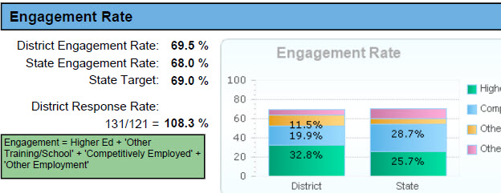
2013 Engagement Report
.
Goal
Notes:
Update with new data- state level data
5 numbers: HE, CE, PSE/T, SOE, NE
RR/Representativeness
Disaggregations: engagement X race/ethnicity, gender, dis cat, method of exit

Slide 17
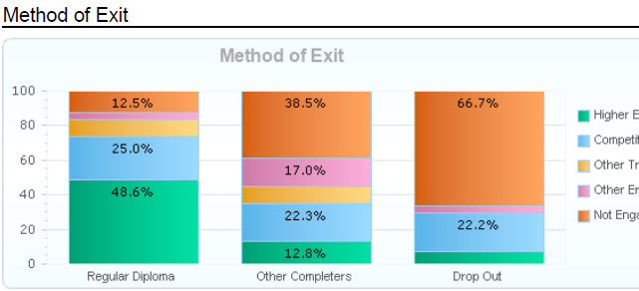
Sample District – Method of Exit
Notes:
Update with State level data

Slide 18
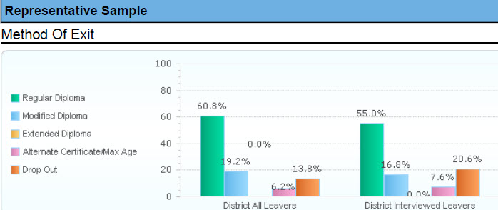
Sample District Data– Representative?

Slide 19
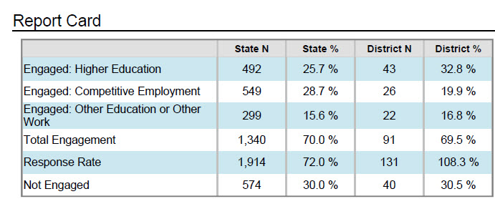
District and State comparisons

Slide 20
Where Do I Get My Data?
The Post School Outcomes Data Reports are on the PSO 2.0 Application
Access is provided through District Security Administrator
District and Building level reports available
Exit data entry now open, signed agreement to participate required
Follow Up list of leavers to interview will be posted early April
Data entry for the Follow Up starts June 1st
Districts must have updated contact information
Primary Exit and Follow Up contacts,
District staff conducting the follow up interviews,
Secondary transition educators.
The Contact List allows state staff to inform appropriate district representatives of trainings and other transition related information.

Slide 21
Questions for the district to consider when looking at reports
What do the most recent data show?
Can we make district-wide statements using our results, or have we missed dropouts or other groups?
Are our students going on to school within a year?
Are they able to get and keep jobs for at least 3 months?
What percentage of our students are actively working or learning within a year of leaving?
Do we have more than a third of our leavers who haven’t done any work or training after leaving high school?
Are we getting better at launching successful students?

Slide 22
Next Steps
Look at the PSO data for your district
Identify areas of strength and areas for improvement
Share and discuss data with stakeholders
Use data to determine what changes are needed
Call Sally and Pattie with questions

Slide 23
For more information:
Sally Simich
Transition Specialist, Oregon Department of Education
Sally.simich@state.ou.us 503-947-5639
Pattie Johnson
Teaching Research Institute, Western Oregon University
johnsop@wou.edu 503-838-8779
Charlotte Y. Alverson
National Post School Outcomes Center, University of Oregon
calverso@uoregon.edu 541-346-1390

Slide 24
